Slide 1
AVDD
AVSS
DVDD
GND
POWER SOURCE
ADS1298 BOARD
16 contacts … changing from mono polar to bi-polar
Analog supply and Digital supply: options to be (separated or together) and (local or tethered)
Analog RLD signal capability (feedback to patient) …
Patient
Bioelectrical signal INPUT
8ch mono/dif
RLD -> Ground
SPI interface with controller
MISO
MOSI
CS
CLK
GND

Slide 2
MISO
MOSI
CS
CLK
GND
DVDD
GND
Interface with ADS
POWER SOURCE
Micro Controller Unit
Serial Interface Port
WiFi - UDP (IP)
Tx
Rx
GND
Prog Baud Rate 2Mbits/s

Slide 3
AVDD
AVSS
DVDD
GND
DVDD
GND
POWER SOURCE ADS
POWER SOURCE micro-Controller

Slide 7
FIRST LOOKING AT ADS1298

Slide 8
ADS1299

Slide 9
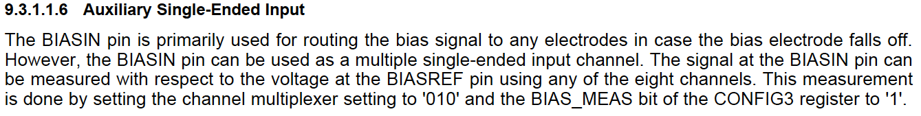
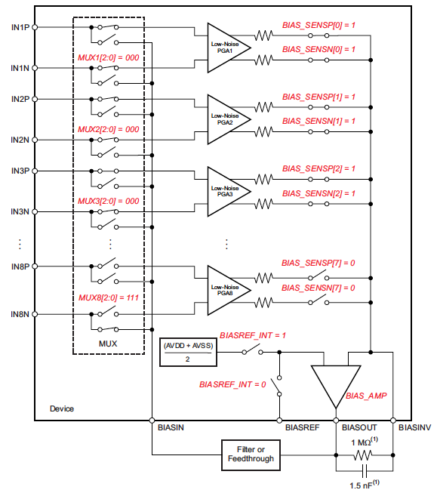
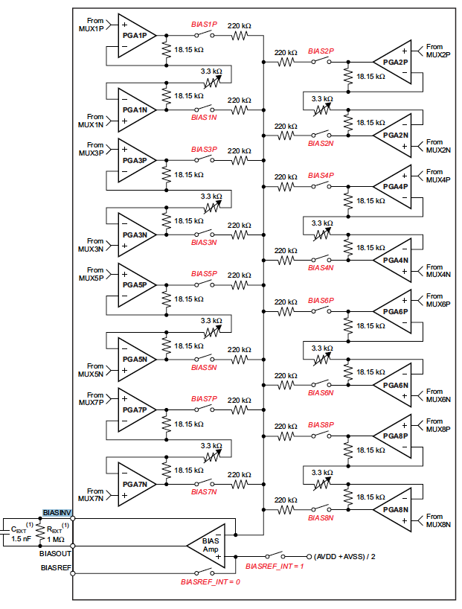
ADS1299

Slide 10
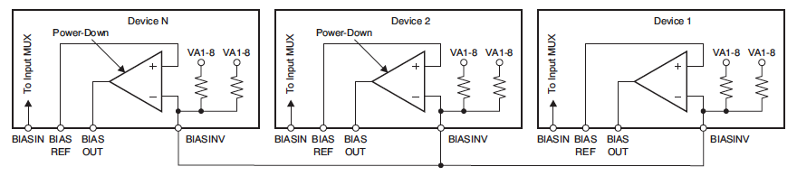
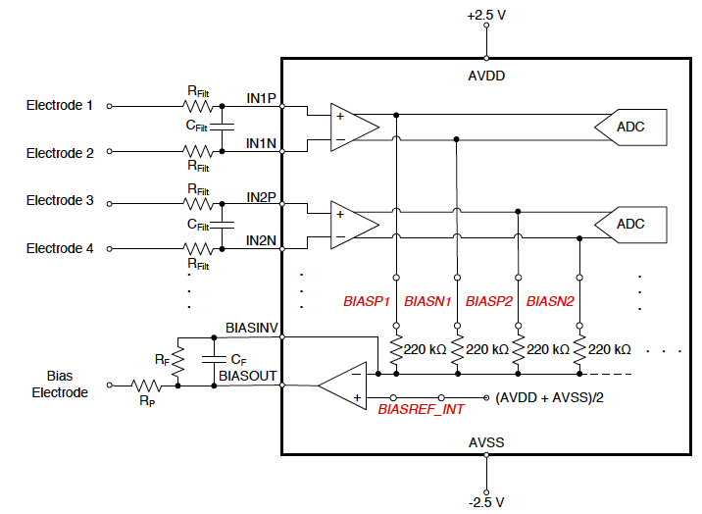
ADS1299

Slide 11
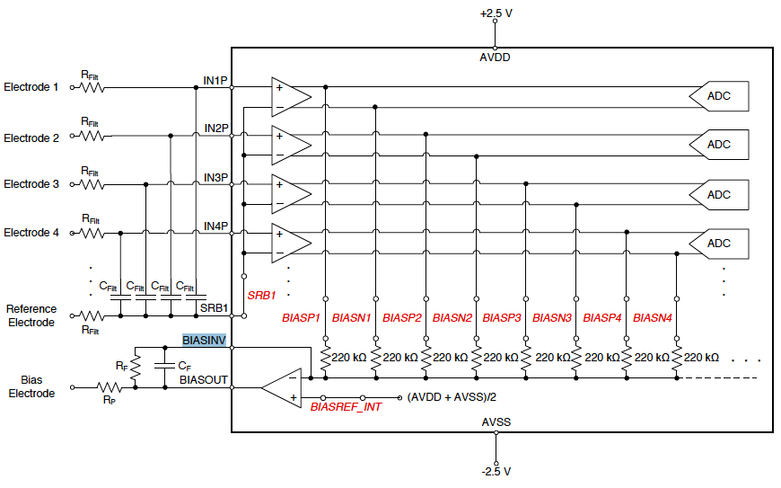
ADS1299

Slide 12
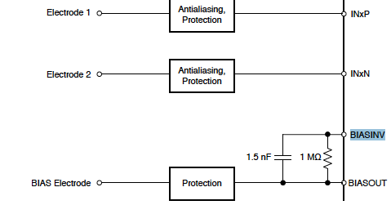
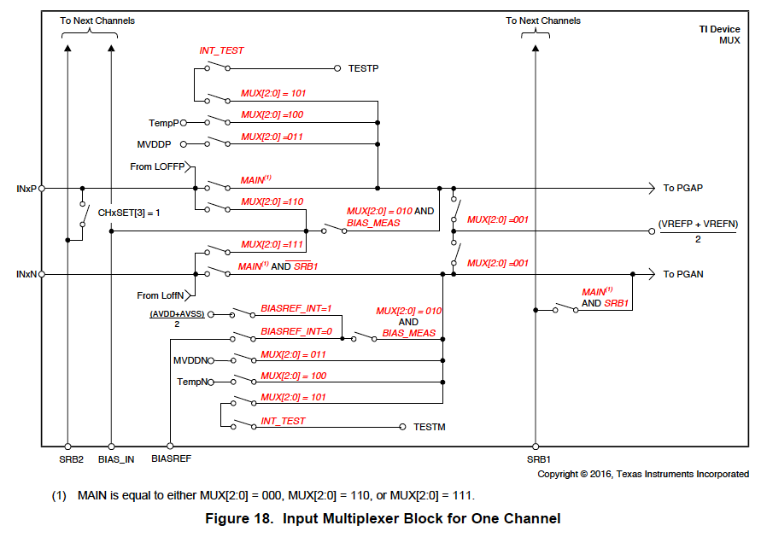
ADS1299

Slide 13
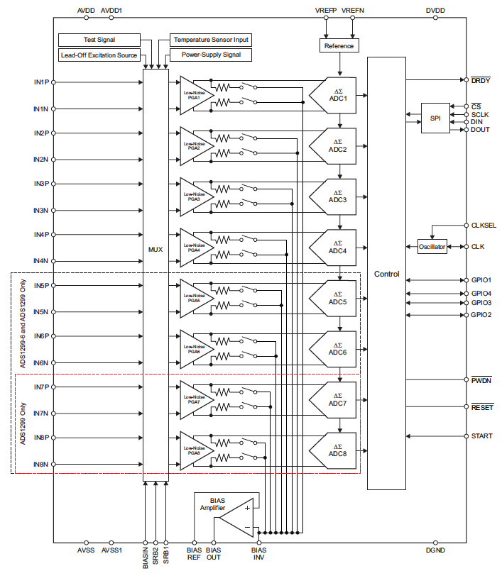
ADS1299

Slide 14
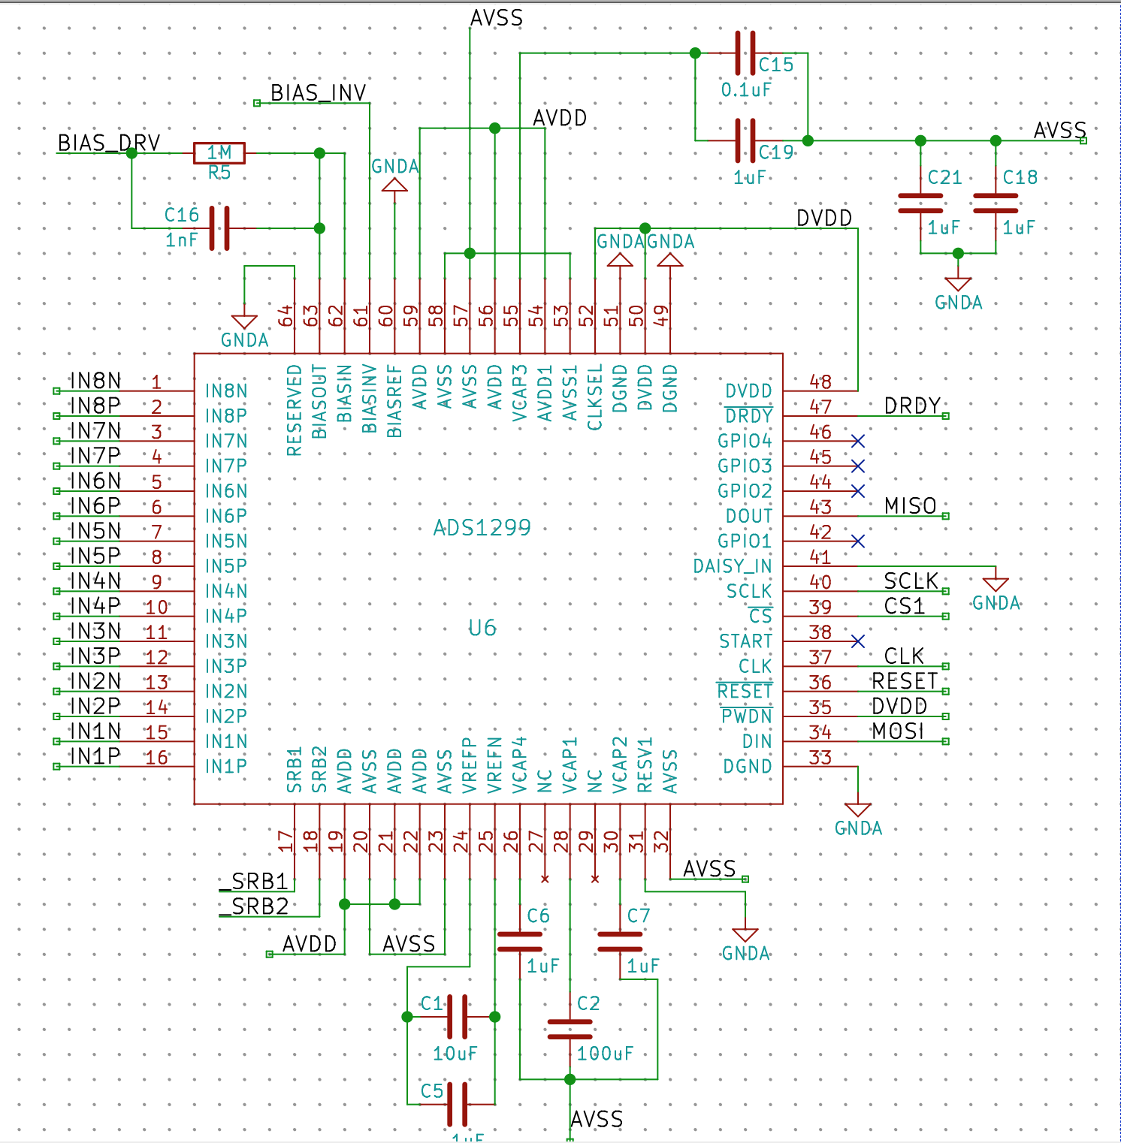
ADS1299

Slide 15
CHANGING TO ADS1298

Slide 16
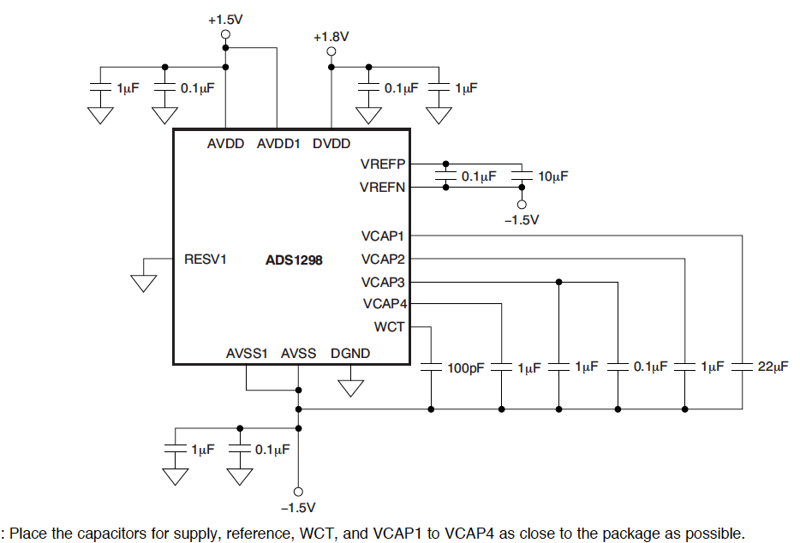
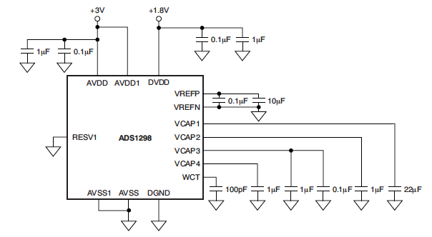
ADS1298

Slide 17
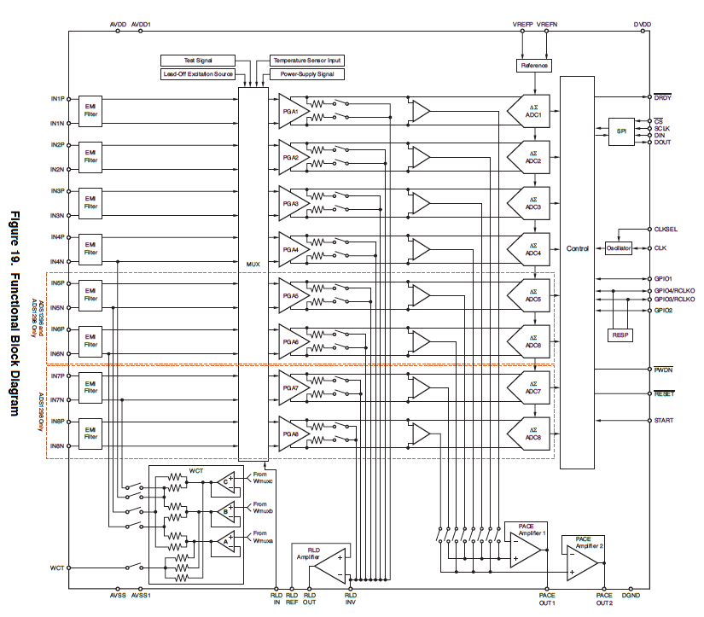
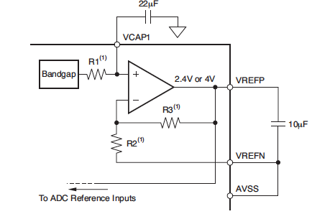
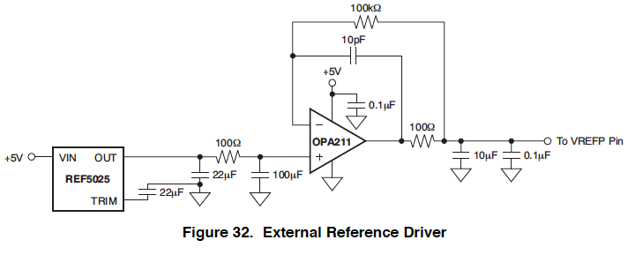

Slide 18
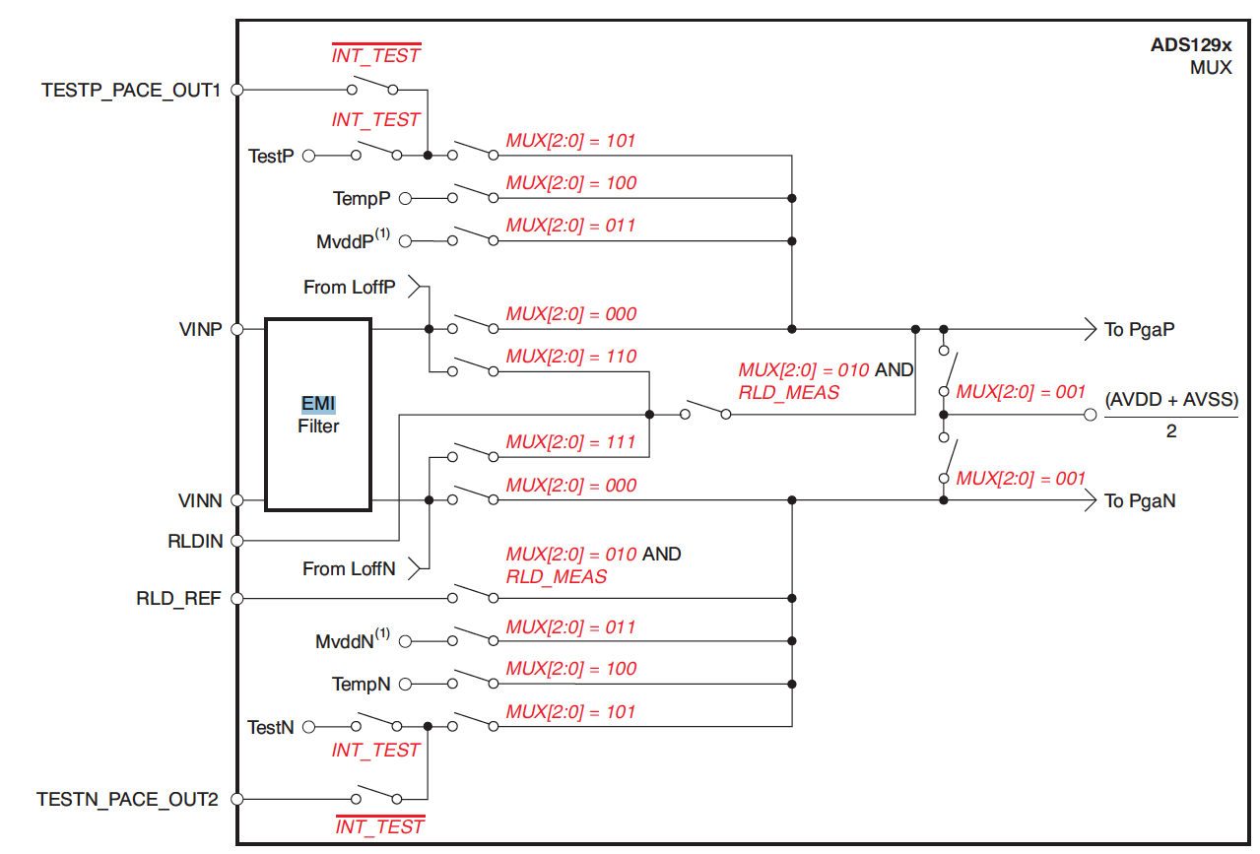

Slide 19
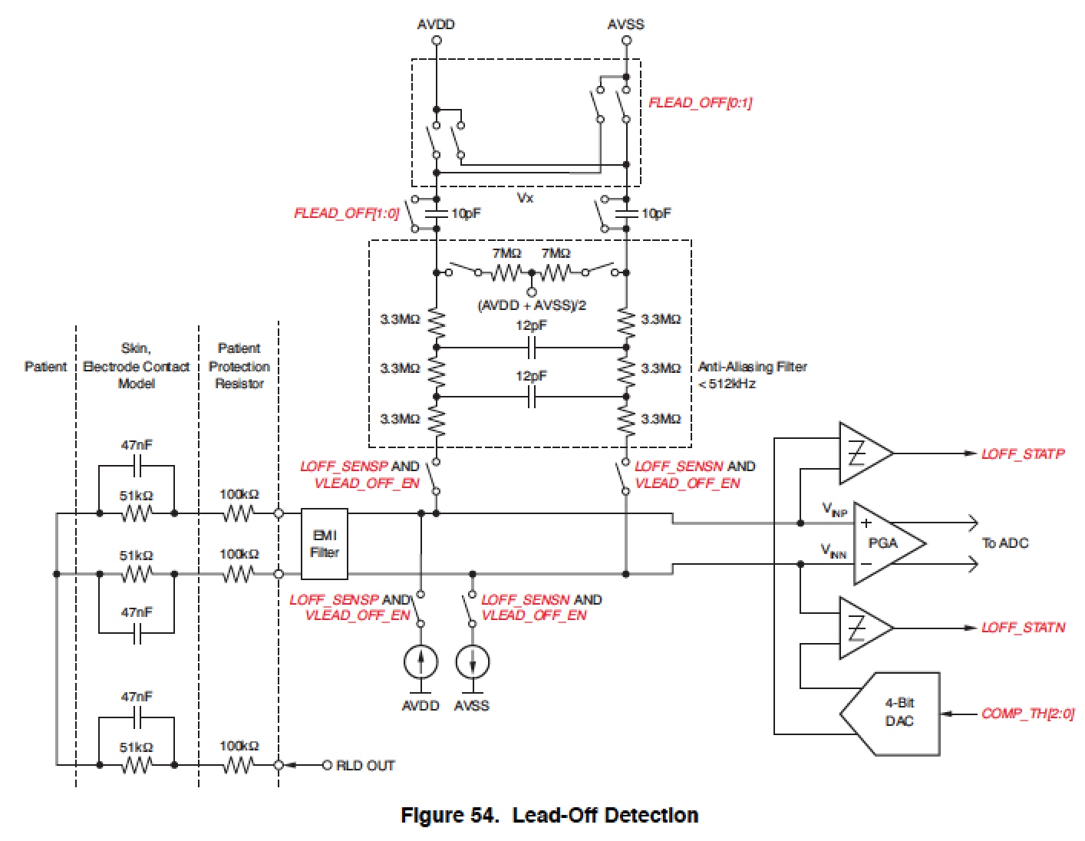

Slide 20
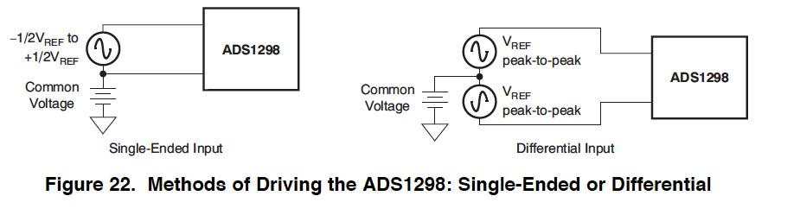

Slide 21
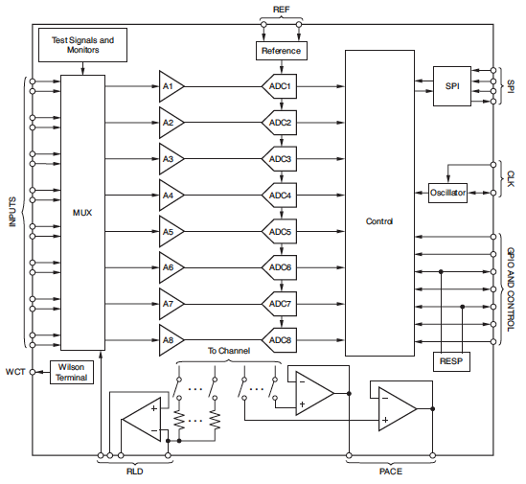
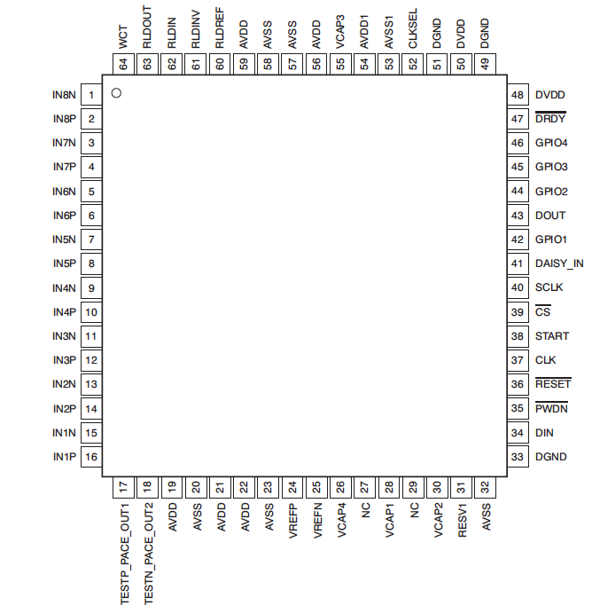

Slide 22
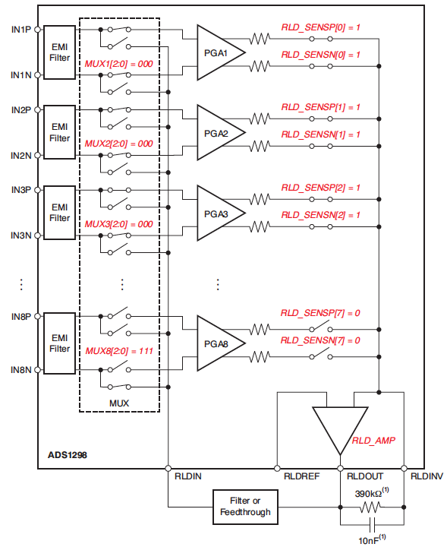

Slide 23
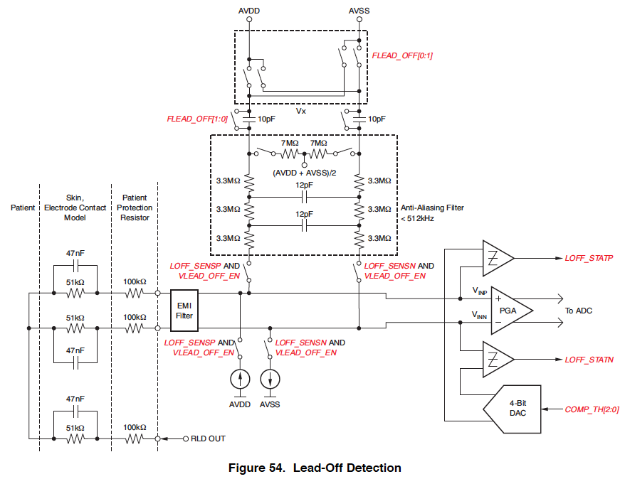

Slide 24
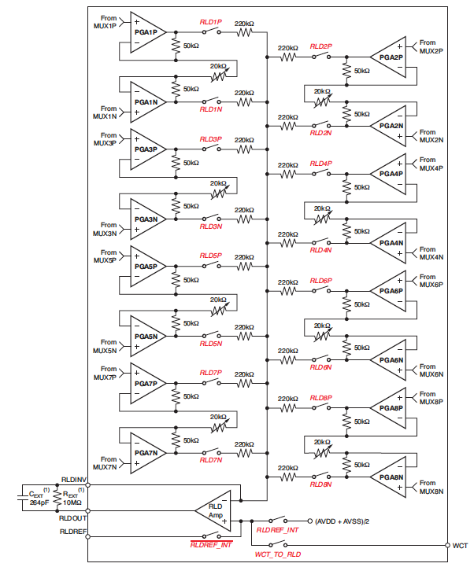

Slide 25
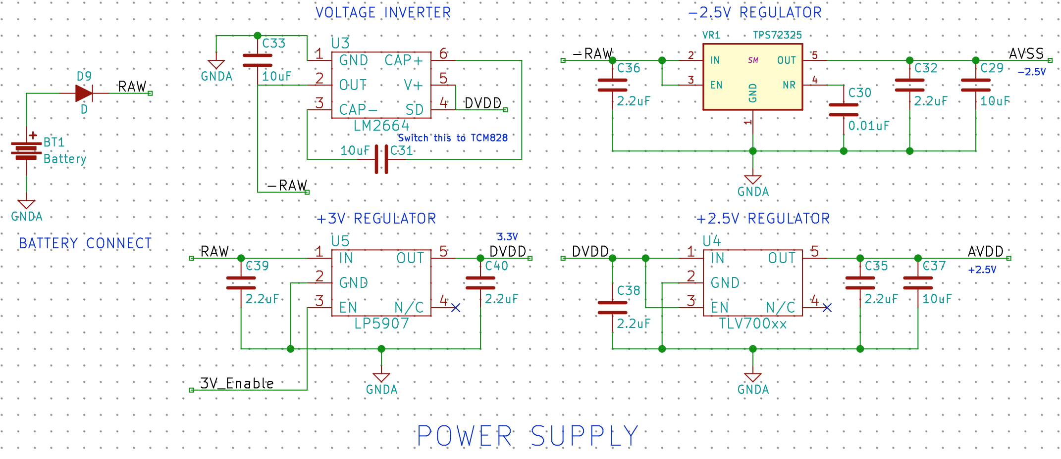
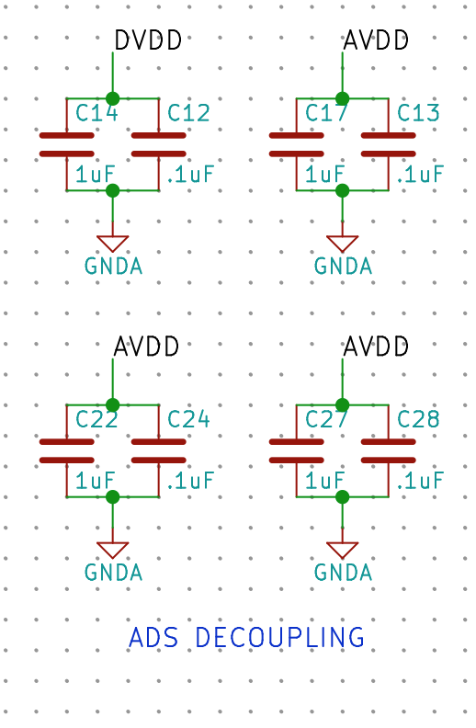
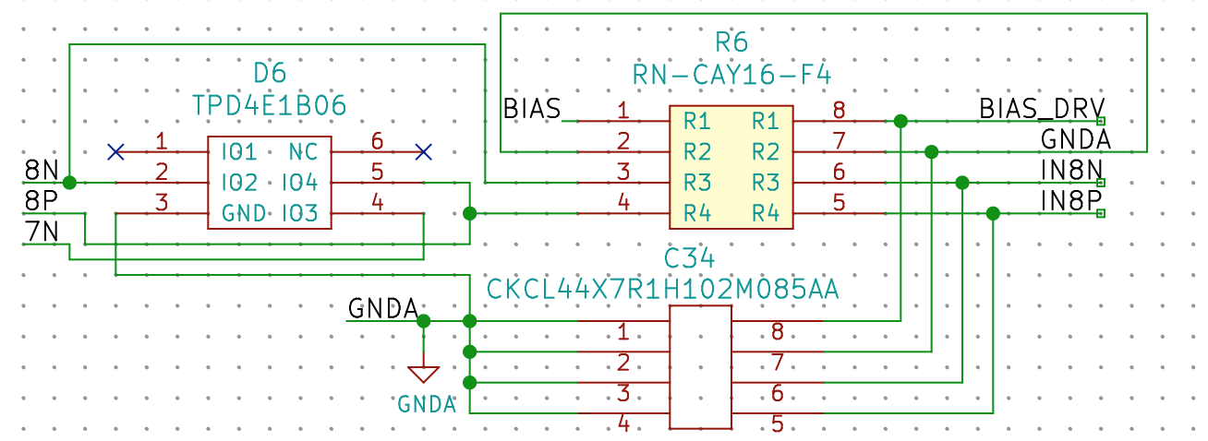

Slide 26
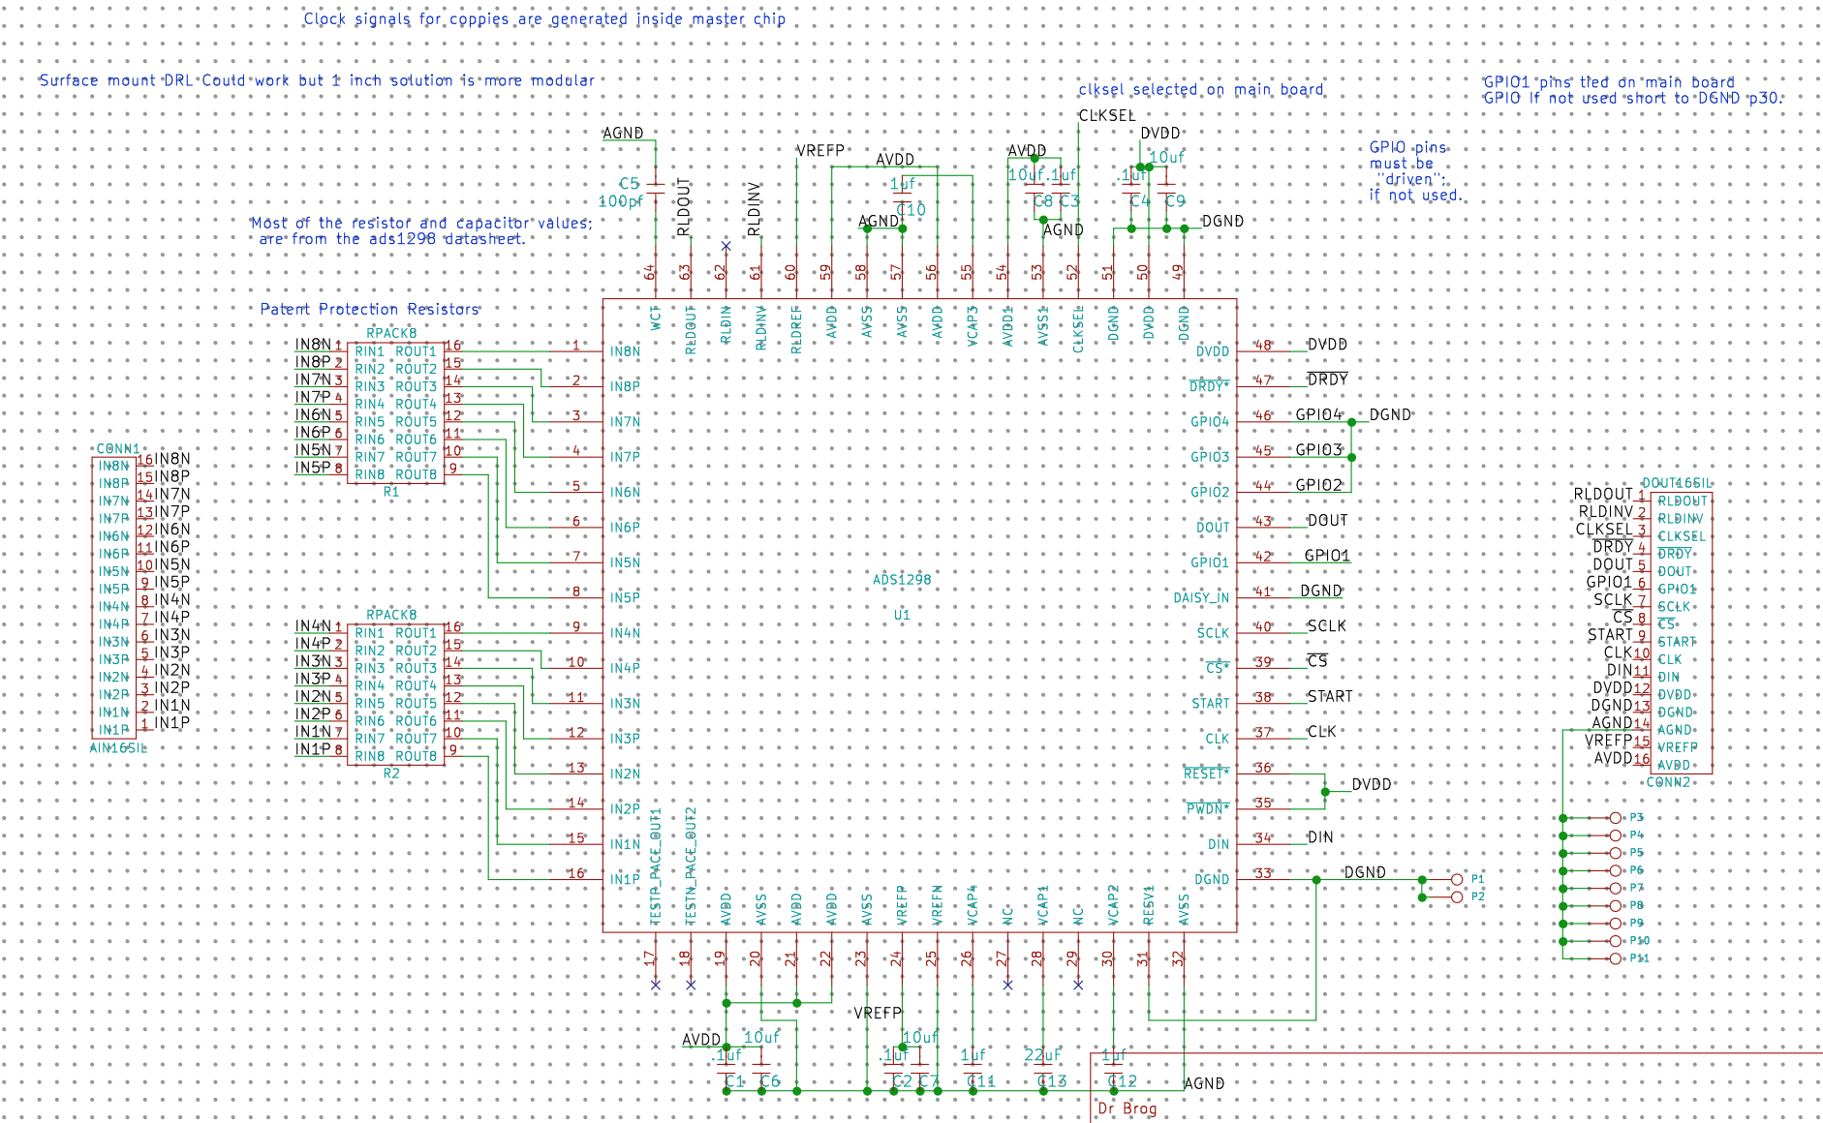

Slide 27
